Slide 1
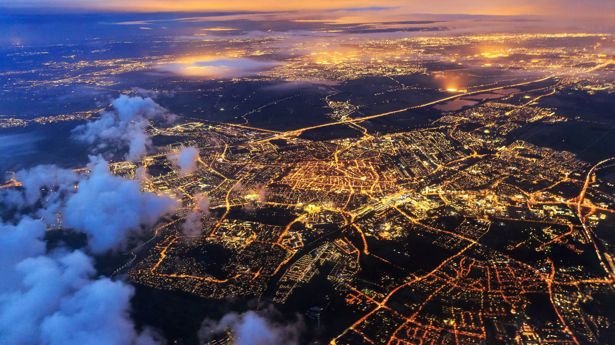
Battle of the Neighbourhoods
Robert Ashton-Jones

Slide 2
Problem Statement
A Canadian entrepreneur is looking to open a new sports nutrition store. This project aims to clarify where the ideal location to open a sports Nutrition store in Toronto would be.
If the original shop is situated well there will be more footfall and a greater chance to generate revenue, which in turn will allow for quicker expansion, and a greater chance of success.
Therefore identifying the best location for the store is a key factor to its success, and the focus of this project.

Slide 3
Objective
The objective of this capstone project is to find the most suitable location for the entrepreneur to open a new sports nutrition store in Toronto. Using data science, including machine learning methods (e.g. clustering), this project aims to answer the question: “Where to start?”
I will use data from the following sources to identify the best location:
- Foursquare – to collect venue data about each neighbourhood
- Wikipedia –neighbourhood data
I will then use venue category data in conjunction with the unsupervised k-means clustering algorithm
Finally, I will use the gathered data about each neighbourhood to determine in which neighbourhood a sports nutrition store is most likely to generate higher revenue

Slide 4
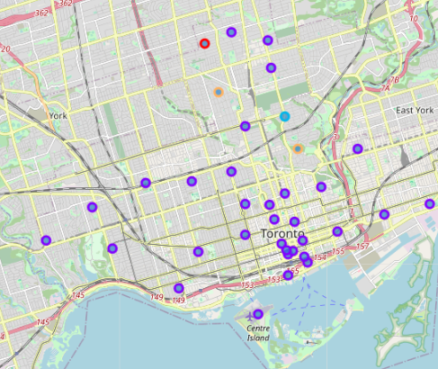
Map of Toronto venue clusters
The Different neighbourhood clusters

Slide 5
Which Borough is best?
Cluster 4 (red) was highlighted as the best cluster for the store to be located
Cluster 4 contained only 2 Neighbourhoods: Rosedale and Forest Hill
Rosedale contained the greatest amount of health related venues in it’s top 10 most common venues. With parks, playgrounds and trails being the most common to both.
As a result of this the ideal location to begin business would be in Rosedale

Slide 6
Conclusion
After researching the number of different venue categories in each neighbourhood, the best neighbourhood to start a sports nutrition business, would be in Rosedale.
This neighbourhood has a low amount of restaurants and a higher frequency of health related stores and this suggests that the population of this neighbourhood is more health focussed.
As a result of the additional organic footfall seen at this location will encourage the success of the entrepreneurs new store

Slide 7
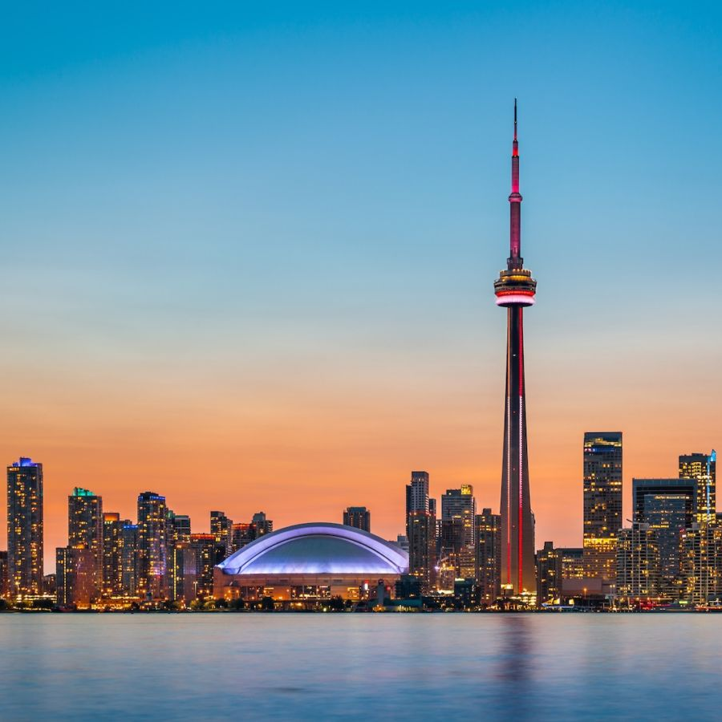
Possible Future project refinements
Due to the time constraints of this project, additional data could be used to refine this research further.
Using other Datasets (such as: frequency of obesity/heart problems; population density; competitor store locations; average income) could help further clarify more ideal store locations in the future

